Slide 1
Knowledge integration through modelling to
inform public health measures
Pierre Nouvellet
pierre.nouvellet@sussex.ac.uk
Modelling infectious disease epidemics, analysis and response
Short course. Bogota. 11-15th December 2017

Slide 2
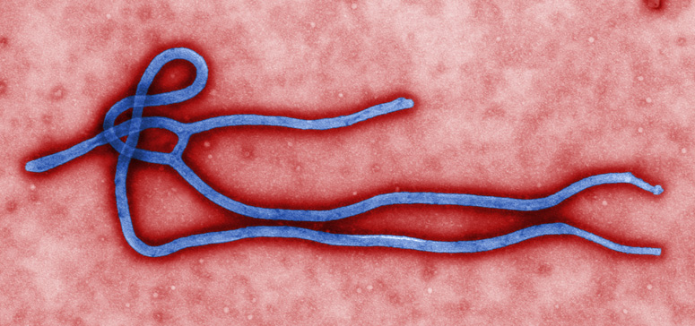
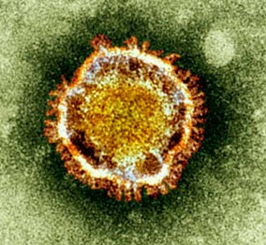
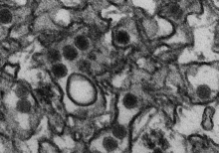
Outline
Context
Modelling & Knowledge integration
Assisting public health response

Slide 3
Context
(re-) Emerging zoonotic virus

Slide 4
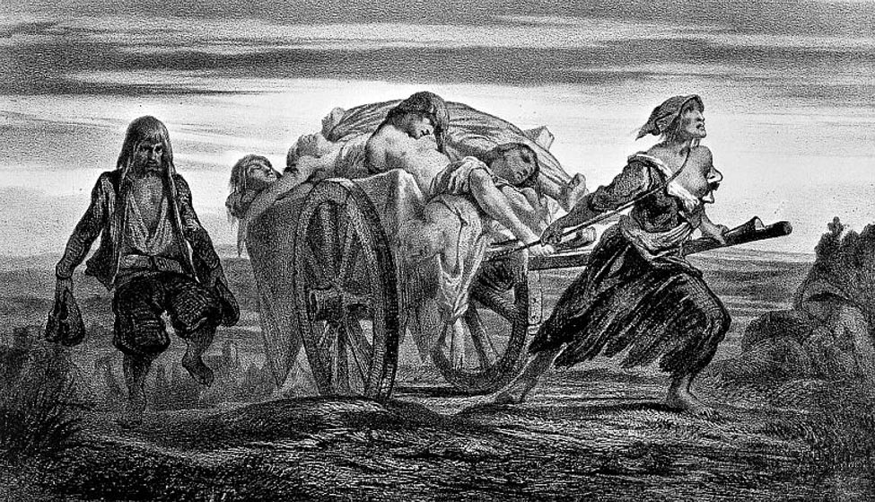
Context
Some are of pandemic potential, historically:
Bubonic plague: bacterial infection, during 14th century the ‘black death’ killed about 25%-60% of the population in Europe.

Slide 5
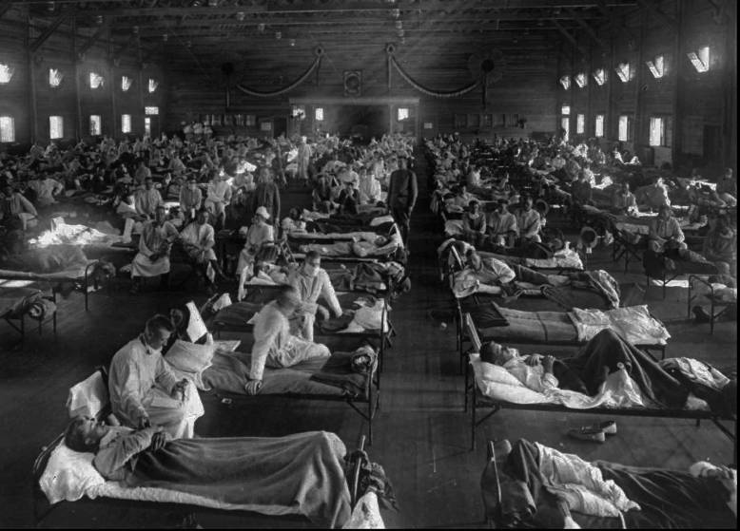
Context
Some are of pandemic potential, historically:
Bubonic plague: bacterial infection, during 14th century the ‘black death’ killed about 25%-60% of the population in Europe.
Influenza virus. Estimations for the 1918 pandemic: 1/3 of population infected, killed more people in 24 weeks than AIDS has killed in 24 years.

Slide 6
Context
From outbreaks to emerging disease

Slide 7
Context
Being prepared and response

Slide 8
Context
In this context, public health actors (e.g. health ministries, public health agencies) must be:
Prepared, e.g. surveillance system.
Rapidly responds to threats, e.g. timely response.
Monitor and evaluate the response to adjust the response in an evolving context.
Modelling can assist in each step by integrating information and extracting meaningful conclusions.

Slide 9
Preparedness
Measuring the risk of emergence, e.g. avian influenza
Trigger system for surveillance
During 2004 influenza pandemic in farmed poultry:
Limited number of human cases, very high case fatality rate (>50%).
385 cases, 243 fatalities (see www.who.int/csr)
First 97 cases showed 8 clusters.
Used branching process theory to estimate R0 and establish ‘trigger’ thresholds for upgrading pandemic threat level.
Ferguson, Fraser et al (2004) Science

Slide 10
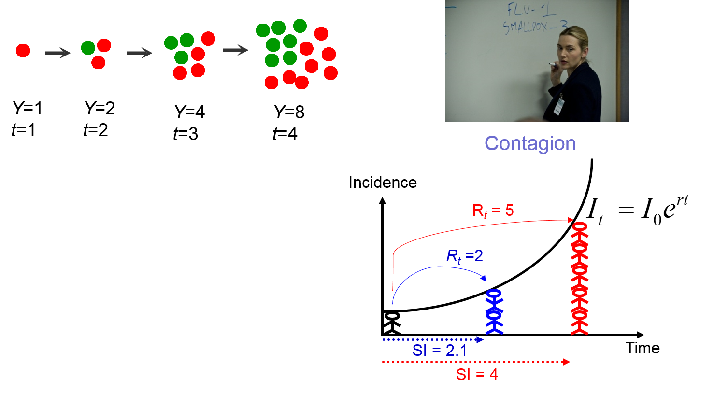
Preparedness
Surveillance and advocacy planning, e.g. Ebola
Estimation of transmissibility
Basic reproduction number R0: average number of secondary cases generated by an index case in a large entirely susceptible population.

Slide 11
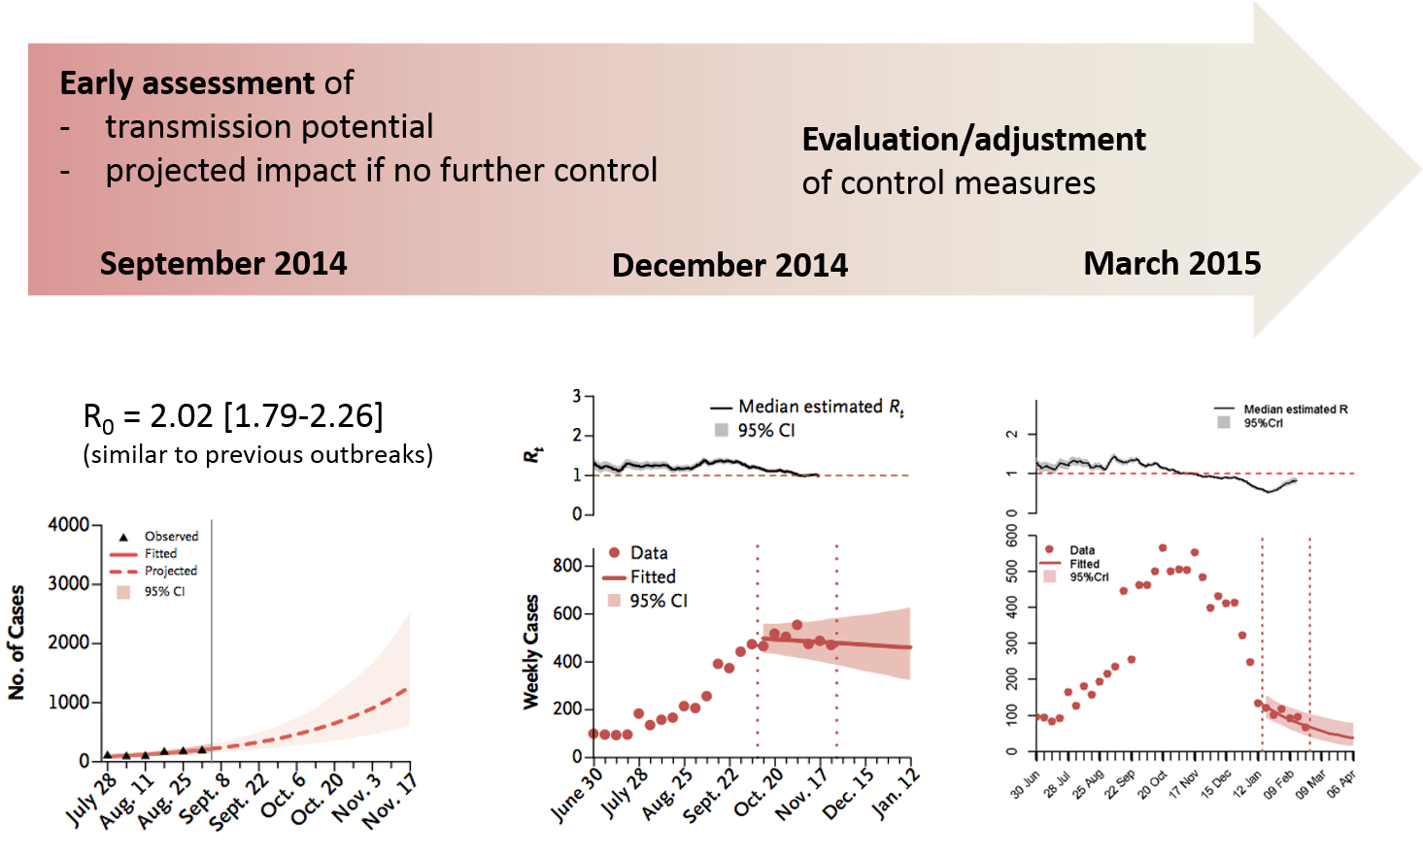
Preparedness
Surveillance and advocacy planning, e.g. Ebola
Estimation of transmissibility
Basic reproduction number R0: average number of secondary cases generated by an index case in a large entirely susceptible population.
WHOERT(2015-16) NEJM

Slide 12
Preparedness
Surveillance and advocacy planning, e.g. Ebola
Estimation of transmissibility
Basic reproduction number R0: average number of secondary cases generated by an index case in a large entirely susceptible population.
WHOERT(2015-16) NEJM

Slide 13
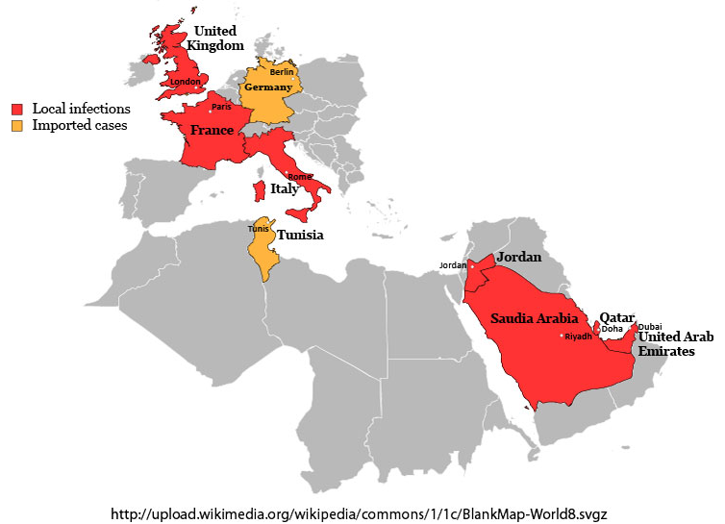
Rapid response
Risk assessment, e.g. MERS-CoV
Evaluate risk of importation
Integrate information on travellers returning to non-endemic area, with transmission model:
Confirmed that MERS-CoV transmission between human was low.
Cauchemez et al. (2014) Lancet ID,

Slide 14
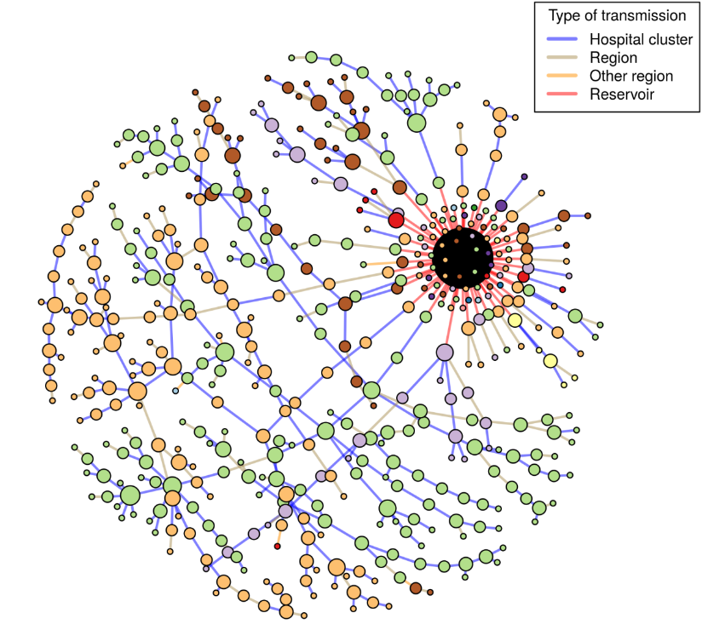
Rapid response
Risk assessment, e.g. MERS-CoV
Evaluate risk of importation
Integrate information on travellers returning to non-endemic area, with transmission model:
Confirmed that MERS-CoV transmission between human was low.
Integrate geographical and epi. information to assess importations from zoonotic reservoir to human:
18% of cases in KSA infected by the animal reservoir (2014).
Important hospital transmission.
Cauchemez et al. (2016) PNAS.

Slide 15
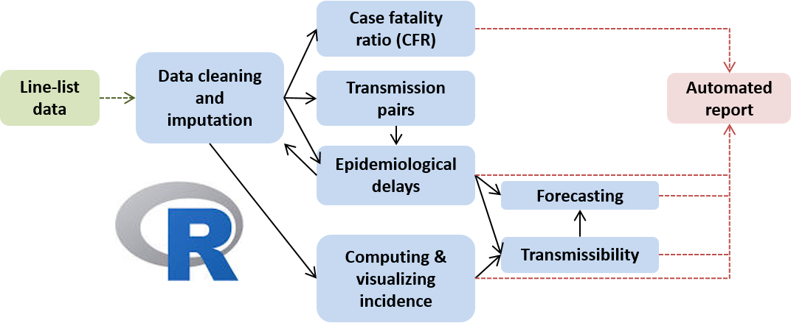
Rapid response
How to achieve the ‘rapid’ in rapid response, e.g. Ebola
Use of automated systems and tool-boxes
During the busiest period of the Ebola response, WHOERT produced biweekly reports to WHO.
Need for an automated procedure:
Quick and reliable.
Update analyses and produce new ones (context).

Slide 16
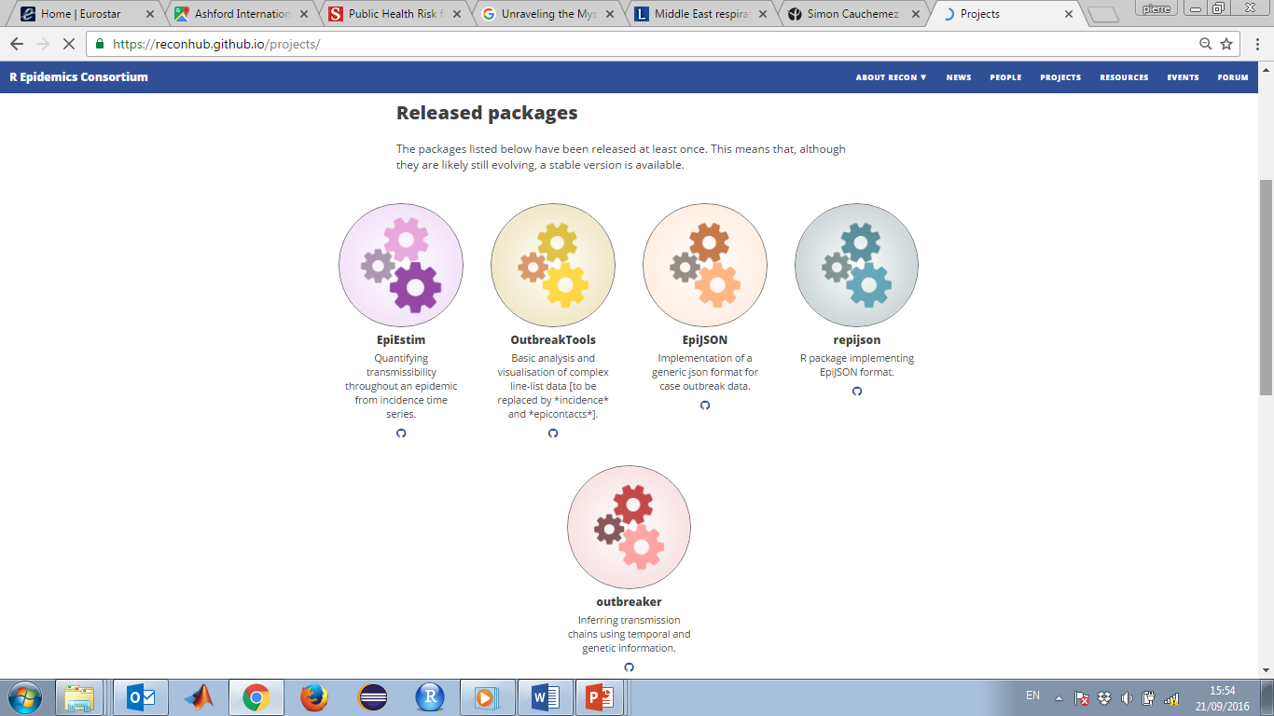
Rapid response
How to achieve the ‘rapid’ in rapid response, e.g. Ebola
Use of automated systems and tool-boxes
During the busiest period of the Ebola response, WHOERT produced biweekly reports to WHO.
Need for an automated procedure:
Quick and reliable.
Update analyses and produce new ones (context).

Slide 17
Monitor, evaluate, and adjust control
Real-time evaluation of intervention, e.g. Ebola
Simple assessment of increased contact tracing
Used method of R0 estimation to relate time taken to isolate patients and local level of transmission.
Reproduction number for a given month was negatively correlated with % of individuals hospitalised within 4 days.
WHOERT (in press) Plos Med.

Slide 18
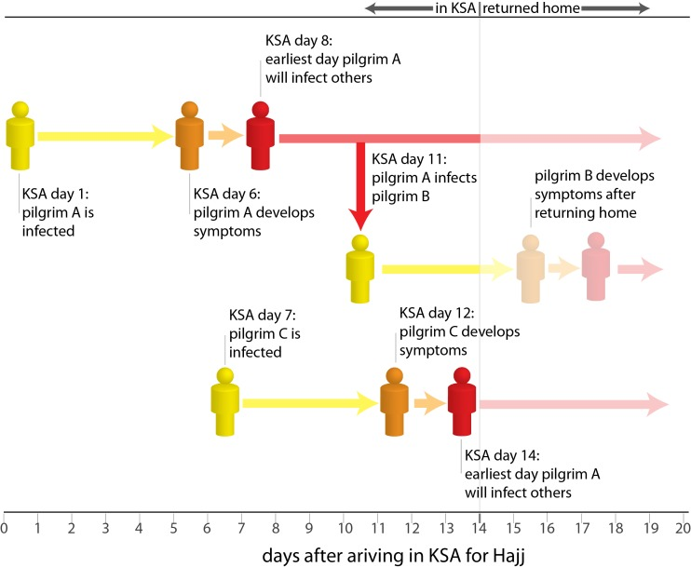
Monitor, evaluate, and adjust control
Prediction of future threat, e.g. MERS-CoV
Scenario modelling and bed capacity
Predict the likelihood of major outbreak during the 2014 Hajj pilgrimage in Saudi Arabia.
Integrate multiple sources of information (e.g. traveller number, duration of stay, hospital capacity, transmissibility) and found a very low risk of outbreak.
Lesser et al. (2014) Plos Current.

Slide 19
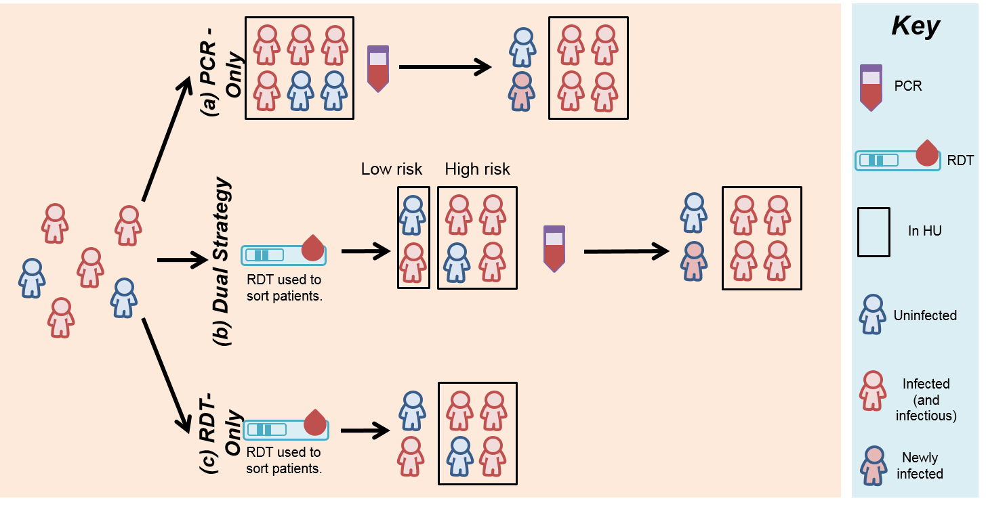
Monitor, evaluate, and adjust control
Retrospective evaluation, e.g. Ebola
Potential impact of rapid diagnostics
Evaluate the impact of potential new rapid diagnostic tools during the West African Ebola outbreak.
Nouvellet et al. (2016) nature.

Slide 20
Monitor, evaluate, and adjust control
Retrospective evaluation, e.g. Ebola
Potential impact of rapid diagnostics
Evaluate the impact of potential new rapid diagnostic tools during the West African Ebola outbreak.
Allows increasingly complex models to be evaluated, e.g. changes in health seeking behaviour, variations in hospital capacity, hospital testing procedures.
Nouvellet et al. (2016) nature.

Slide 21
Conclusions
Models are powerful tools to integrate multiple sources of information in a coherent manner.
Becoming standard tools to advise stakeholders and actors of the public health response.
Existing methodology to deal with
Various phases of an outbreak (from emergence to endemicity),
Various data requirement.
Efforts are ongoing, but preparedness must improve.

